Slide 1
Distance Sensing and Measurement with HC-SR04 Ultrasonic Sensor
Mubashara Rehman
6217000042

Slide 2
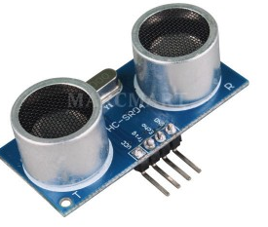
HC- SR04
VCC – 5V (ranging from 4.5 V to 5.5 V)
Trig – Sensor input (trigger)
Echo – Output Sensor (Echo)
GND – Ground

Slide 3
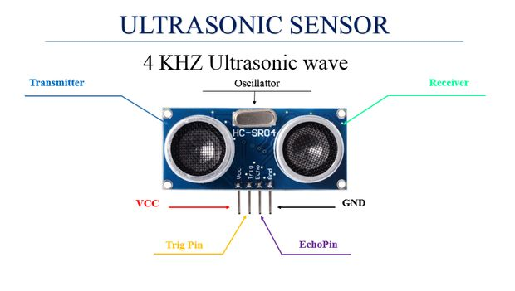

Slide 4
Components Required
HC- SR04
Three resistors of 220 ohms
Three resistors of 330 ohms
Jumper wires;
Three LEDs of different colors;
Breadboard

Slide 5
Connections
Digital ports 10, 11 and 12 of the resistors connected Arduino, which in turn are connected the legs of the LEDs positive;
Cathode pin of the LED in the GND (ground) of the Arduino;
VCC pin of the ultrasonic sensor HC-SRO4 in Arduino 5V;
TRIG pin sensor HC-SRO4 digital port on the Arduino 6;
ECHO pin sensor HC-SRO4 the digital port 7 of the Arduino;
GND pin HC-sensor SRO4 in Arduino GND.

Slide 6
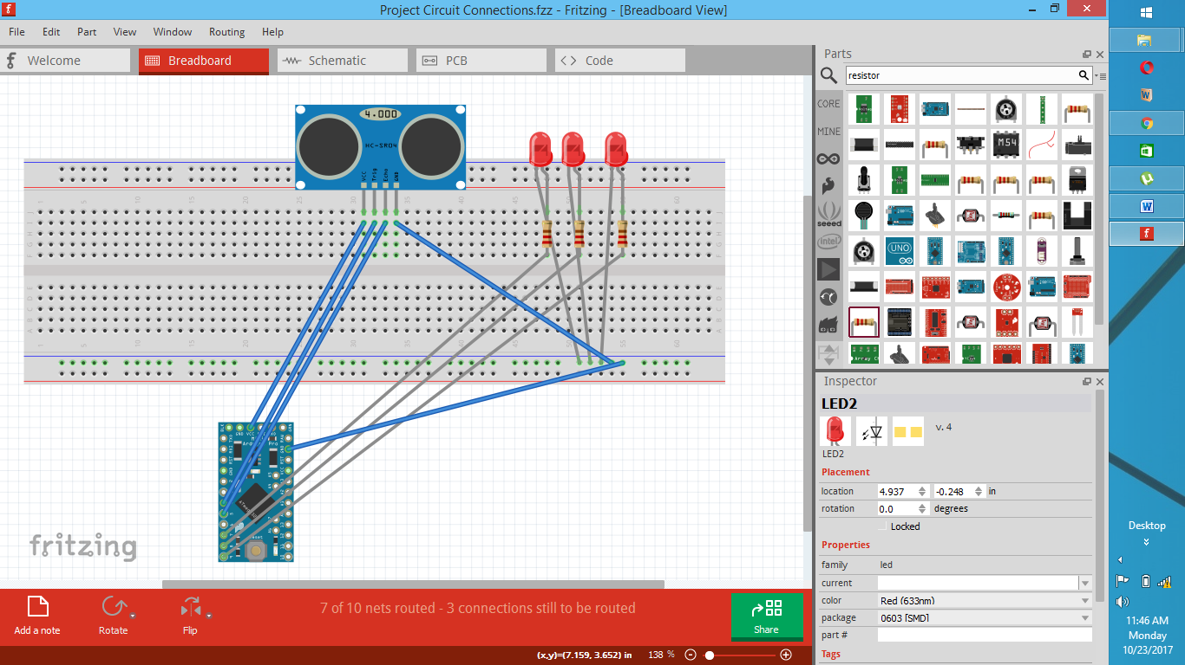
Circuit Diagram

Slide 7
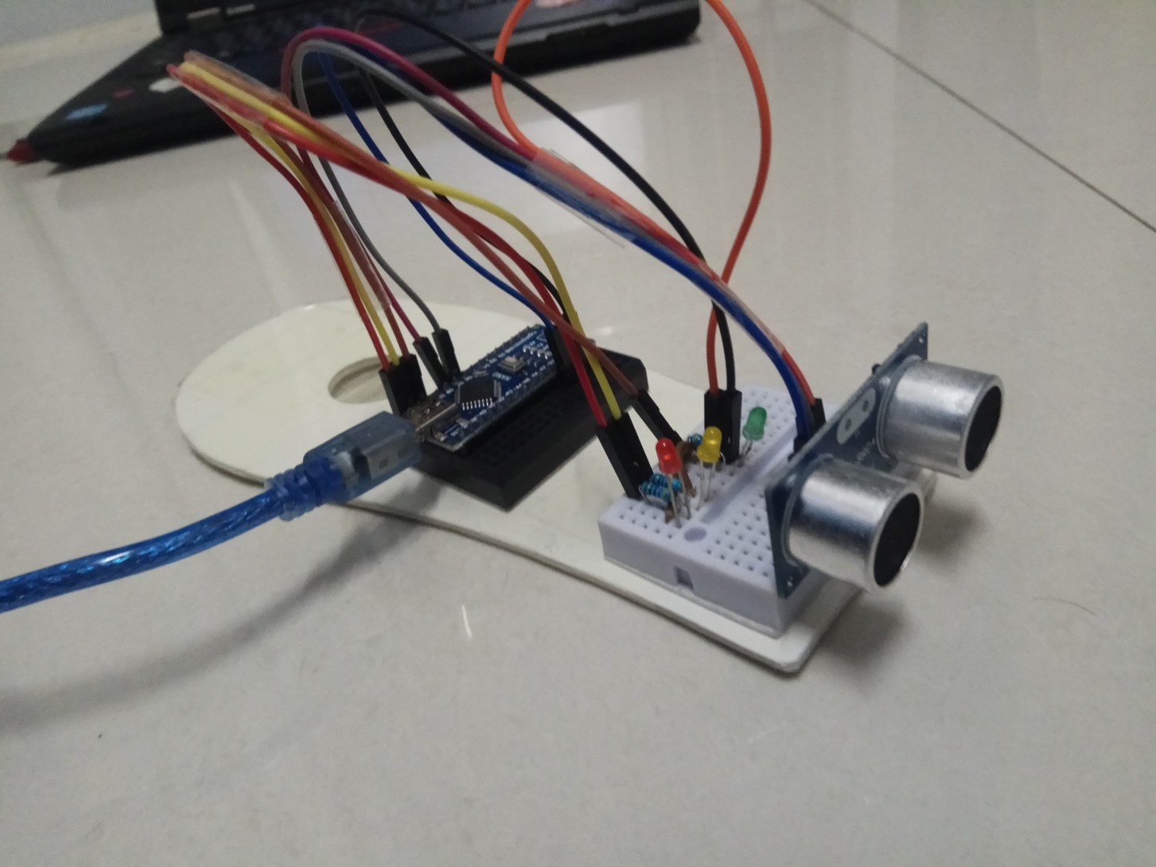
Project Hardware

Slide 8
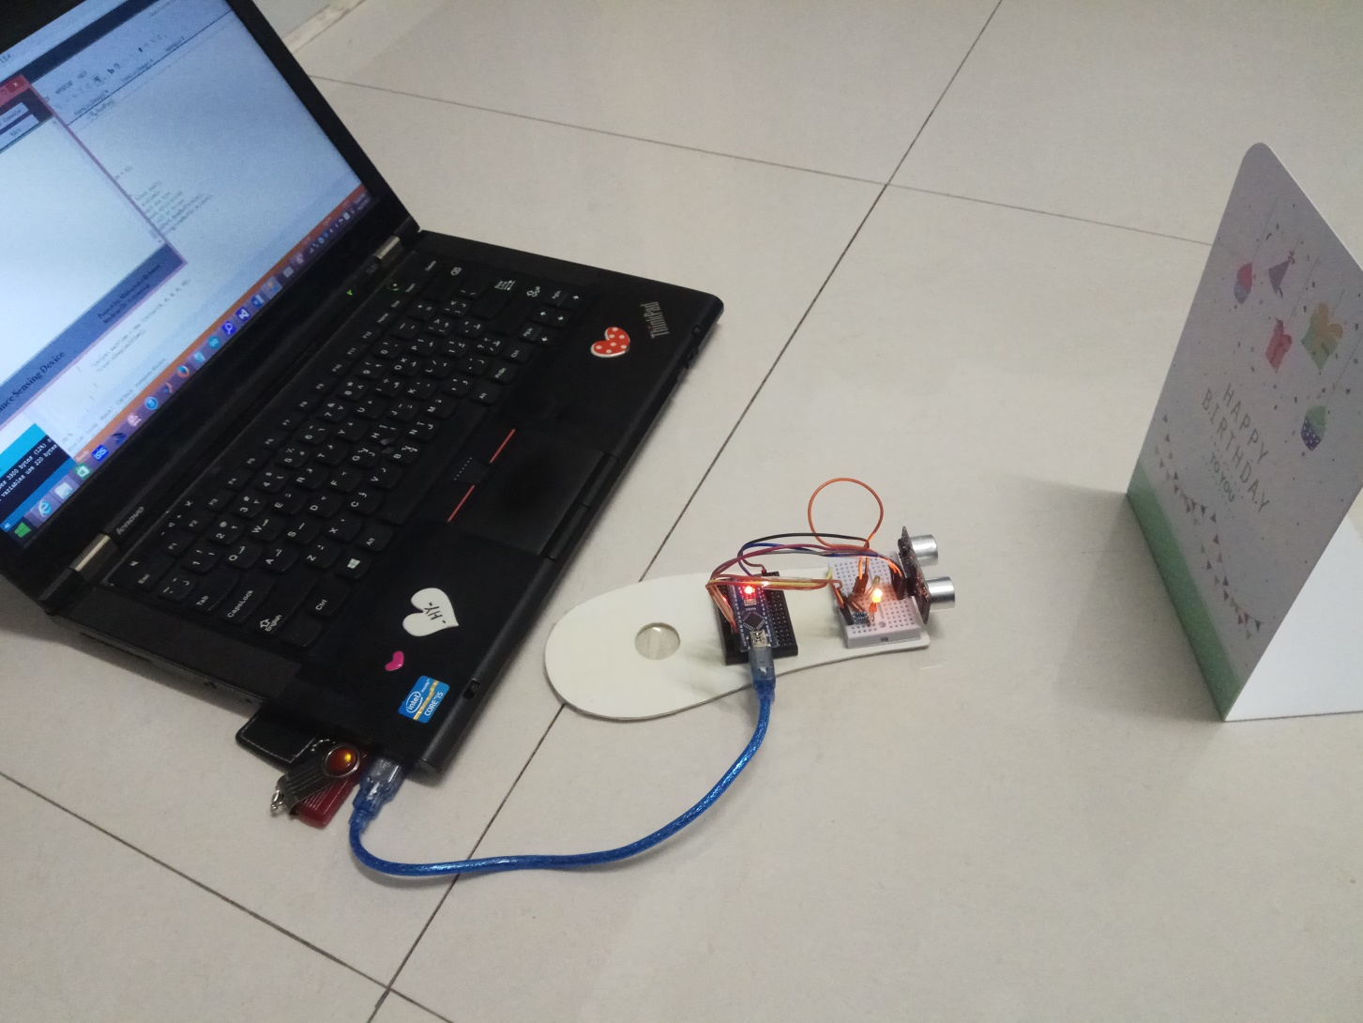
Hardware Assembly

Slide 9
Project Screenshots
a. Main Screen of “Distance Measuring System”
b. Interface of Port Settings
c. Console Output

Slide 10
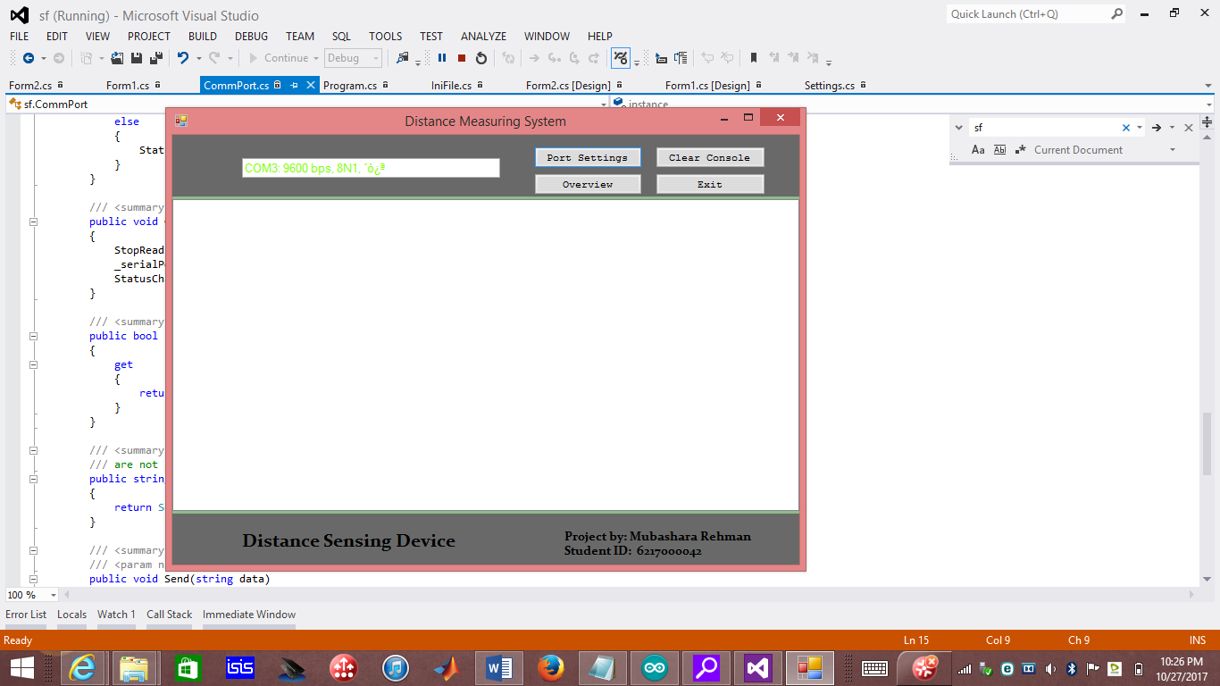
Main Screen of “Distance Measuring System”

Slide 11
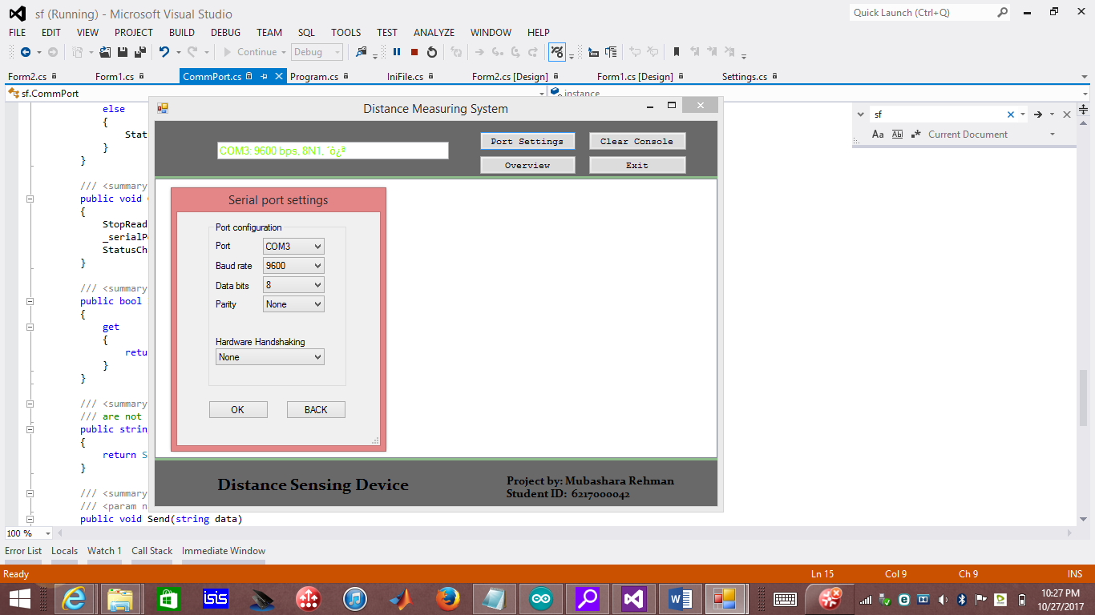
Interface of Port Settings

Slide 12
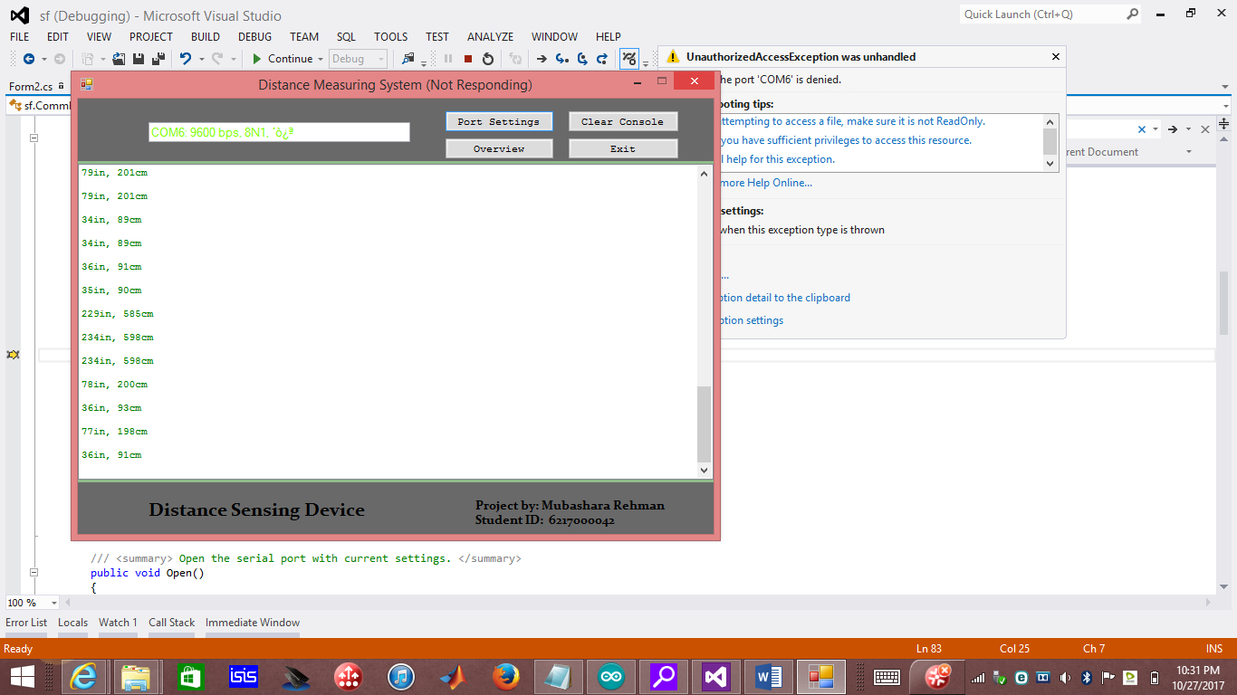
Console Output

Slide 13
References:
http://www.buildcircuit.com/obstacle-sensor-using-arduino-and-hcsr04/
https://www.youtube.com/watch?v=Fn6mVEKSLZc&feature=youtu.be
http://www.instructables.com/id/Ultrasonic-Sensor-HC-SR04-Arduino-Project/
https://create.arduino.cc/projecthub/onyx/ultrasonic-sensor-alarm-1ec0f3

